Slide 1
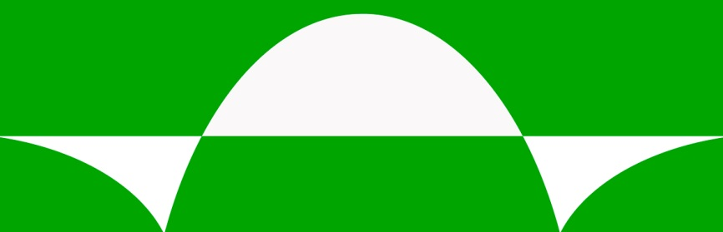
EVERWALL
Evergreen Walls, Inc.
6069 Oakbrook Parkway
Norcross, Georgia 30093

Slide 2
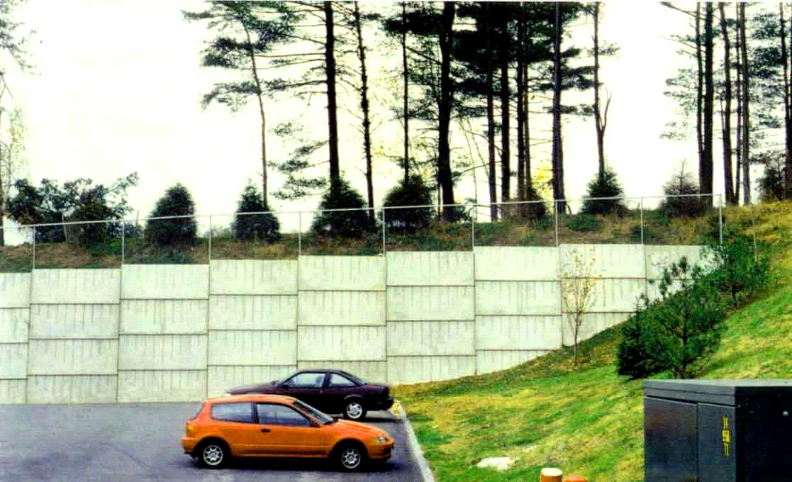
Everwall in Connecticut, USA

Slide 3
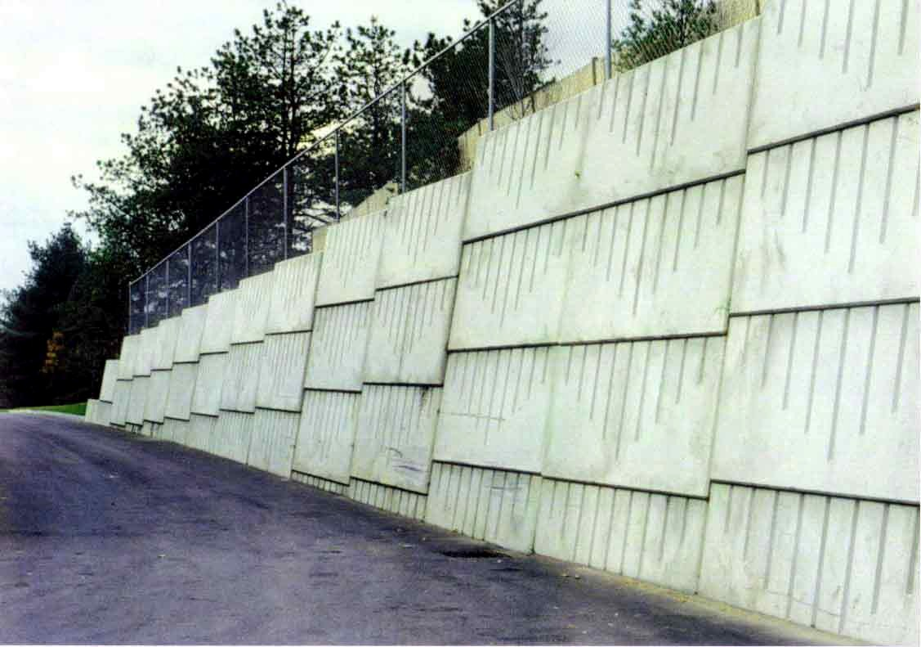
Everwall behind a parking lot, USA

Slide 4
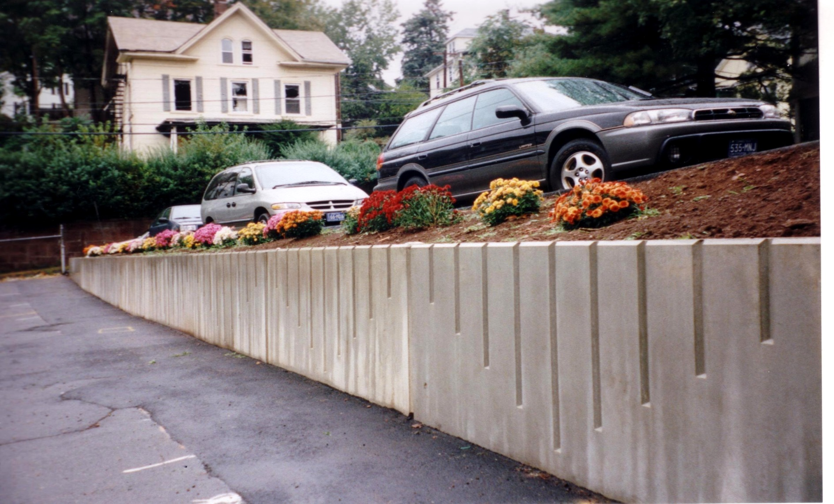
Everwall for small walls

Slide 5
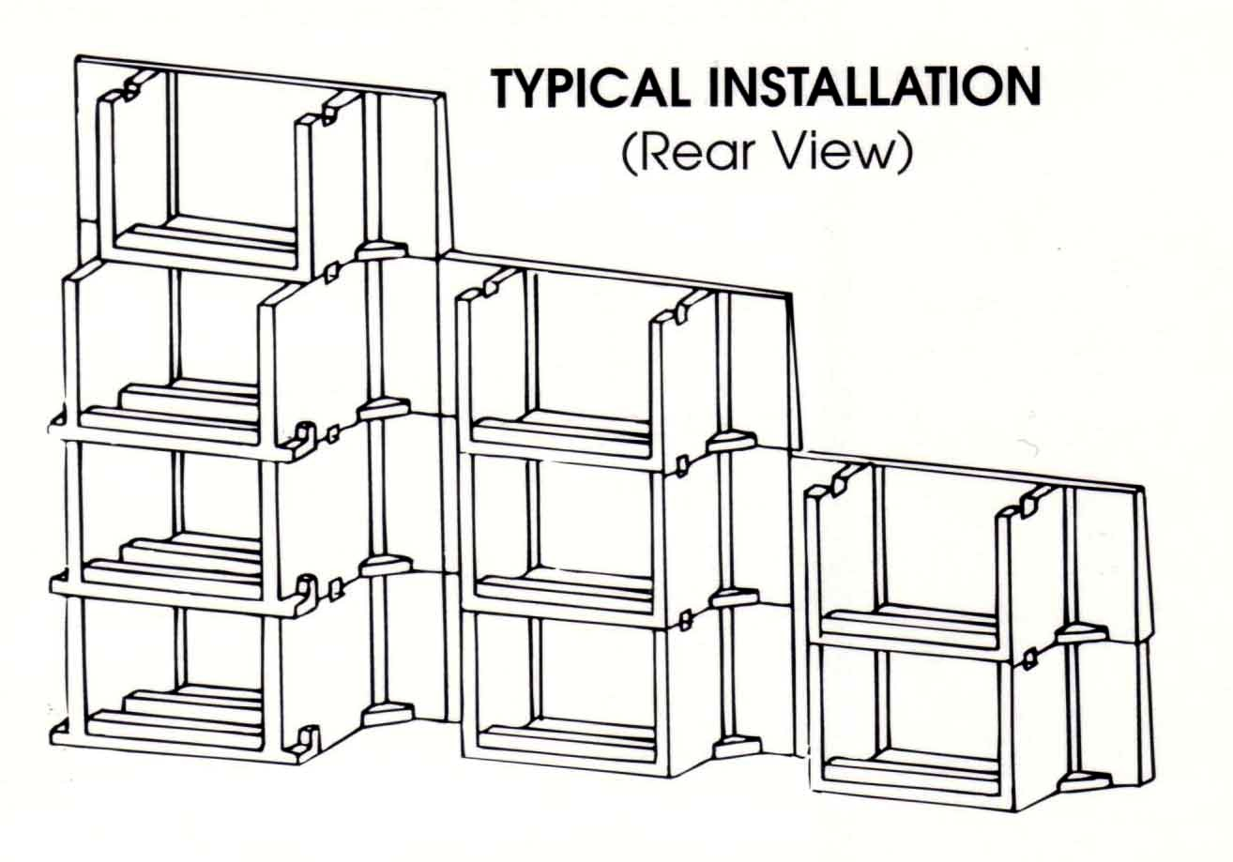

Slide 6
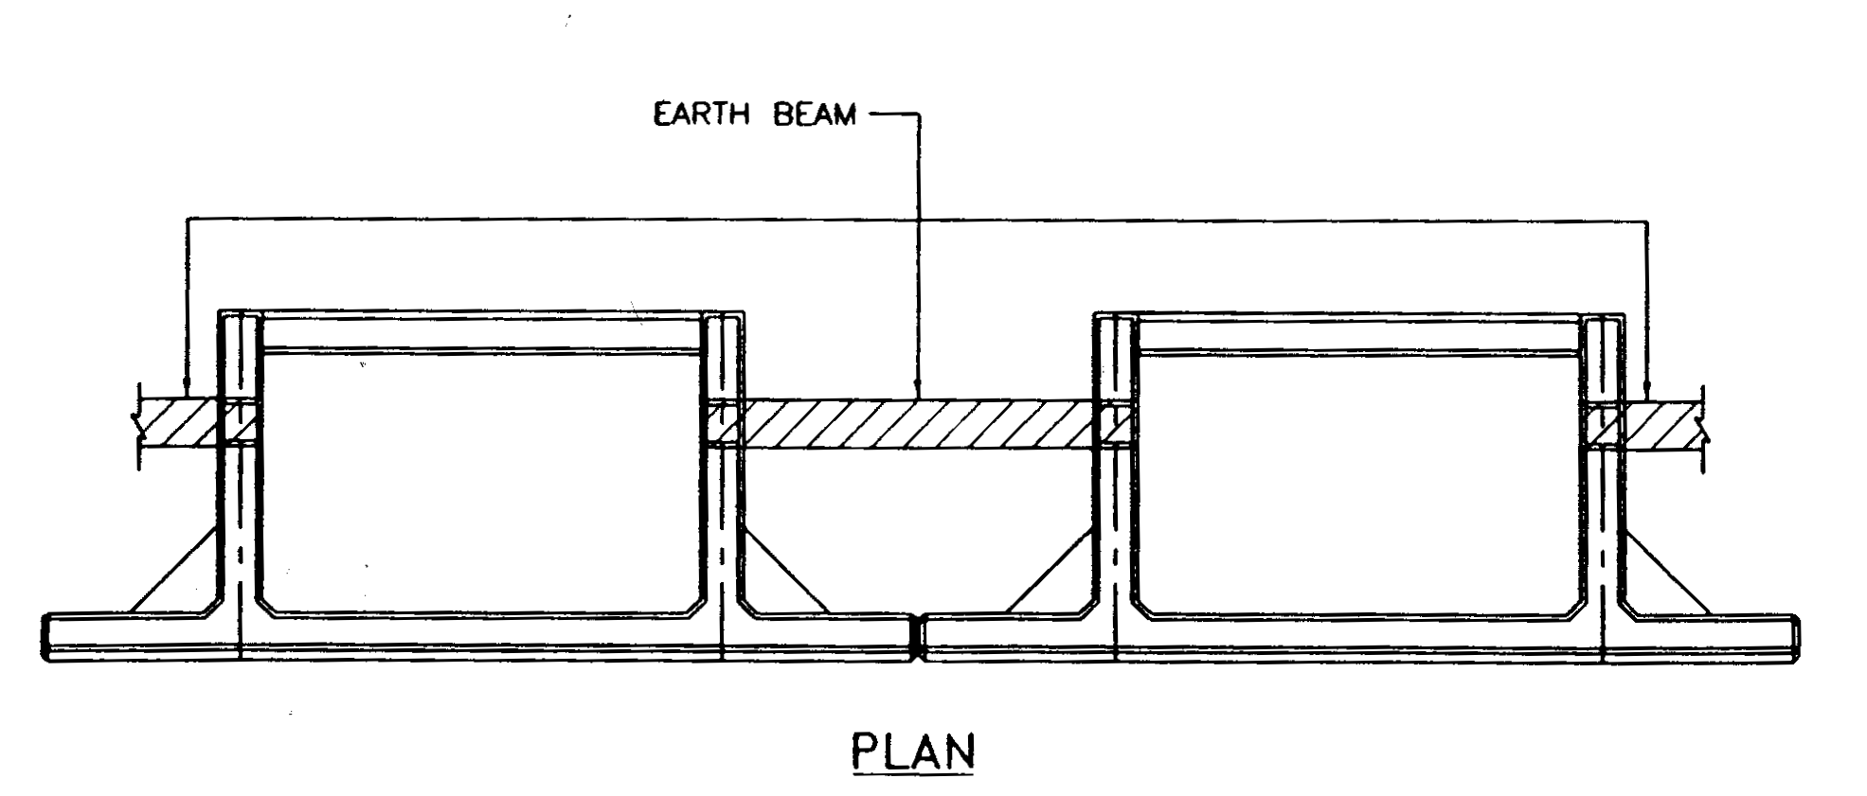
Plan View of Units

Slide 7
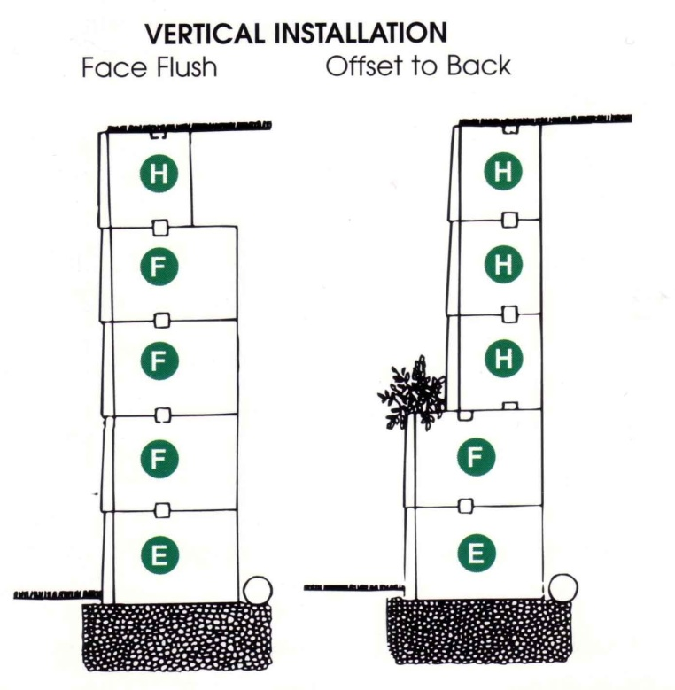
Vertical Installation

Slide 8
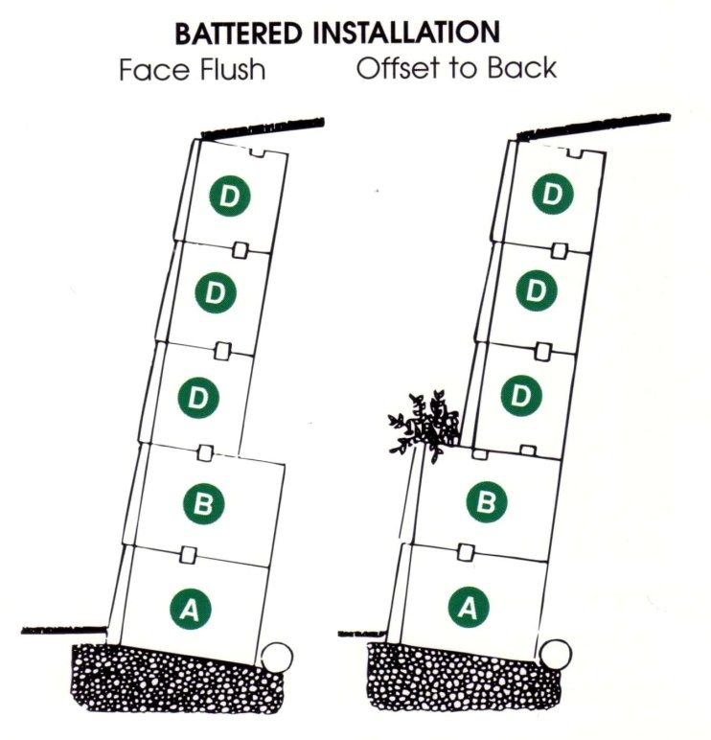
Battered Walls with Room for Plants

Slide 9
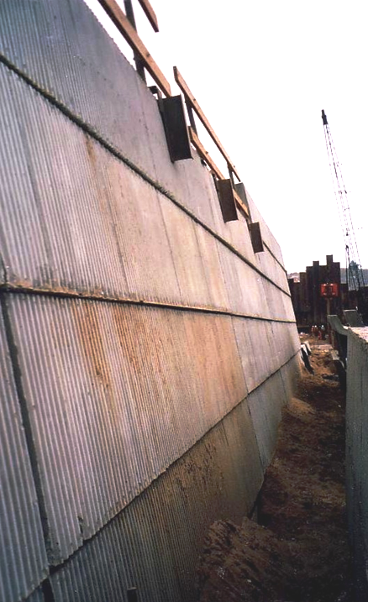
Seawall under Construction in Avila Beach, California, USA

Slide 10
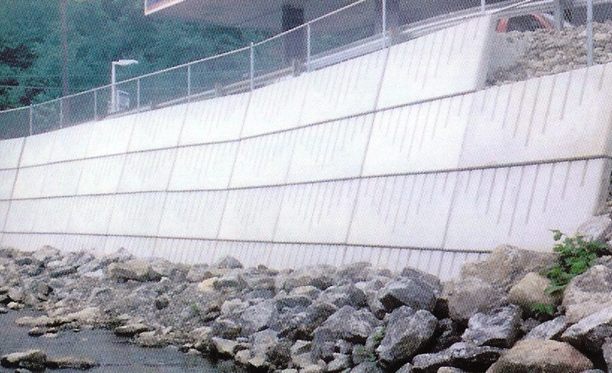
Along a River in Connecticut, USA

Slide 11
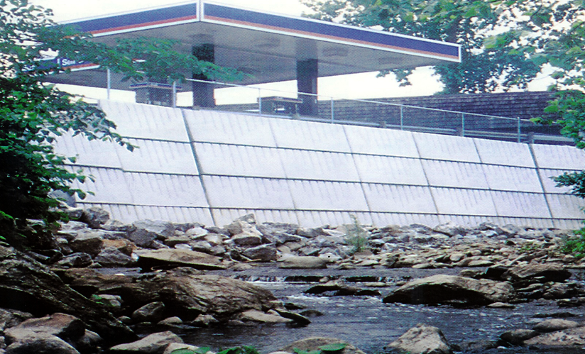
Along a River in Connecticut, USA

Slide 12
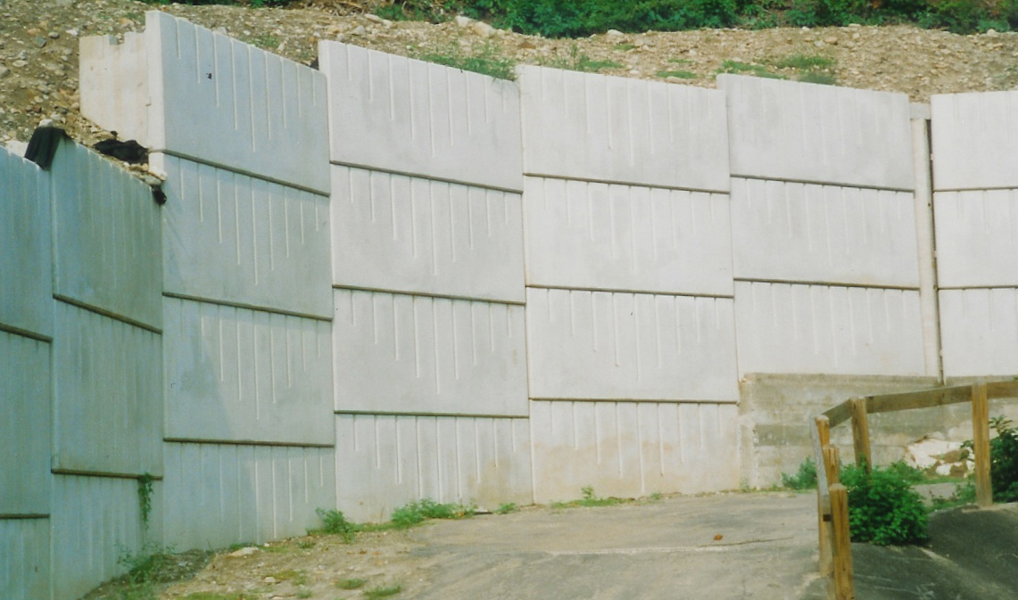
Everwall in a Bend

Slide 13
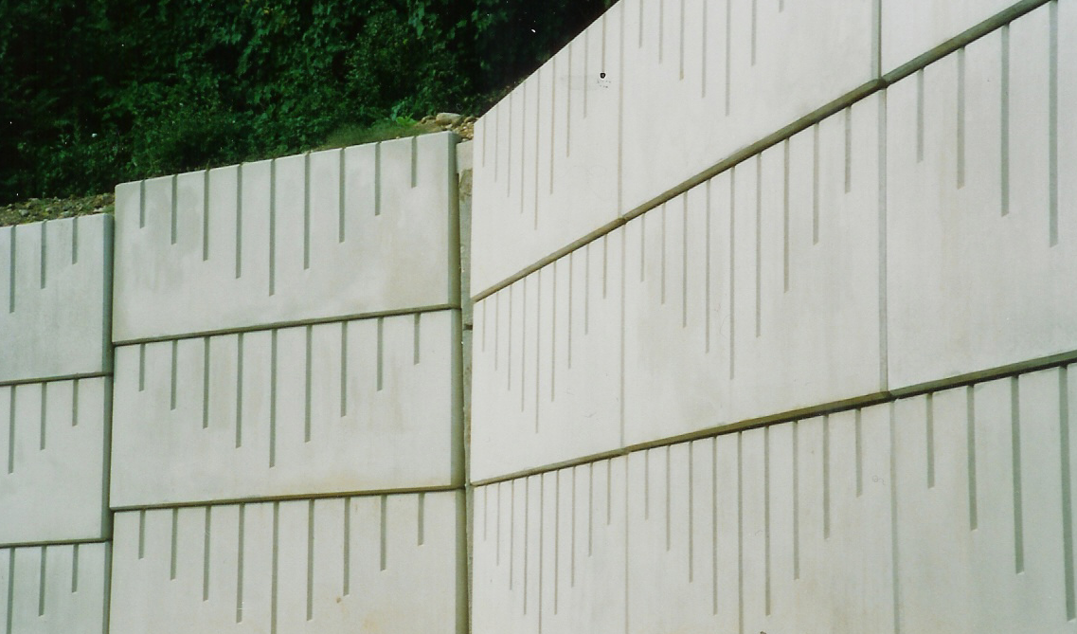
Detail of a Bend with Corner Details

Slide 14
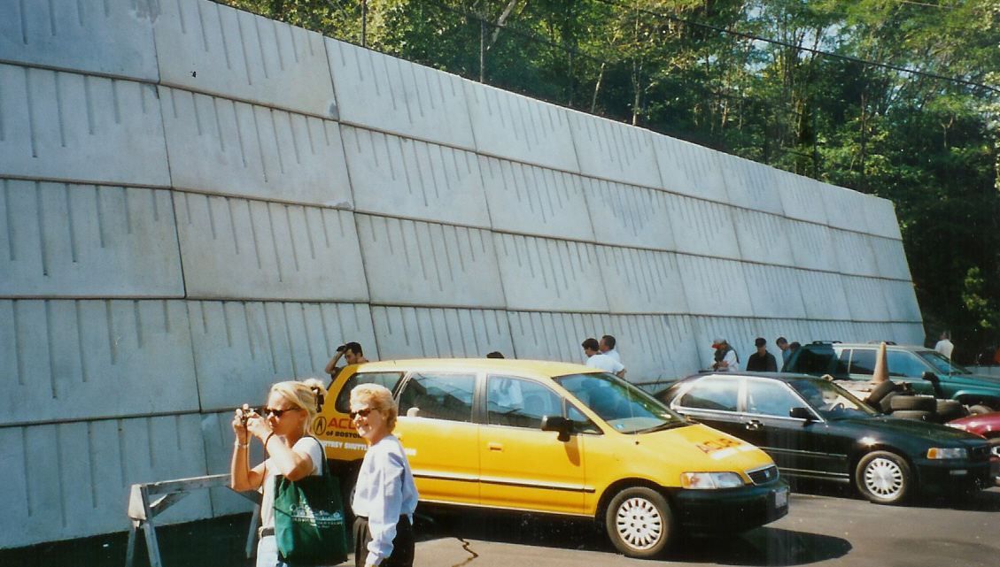
Car Dealer Parkinglot, Boston, USA

Slide 15
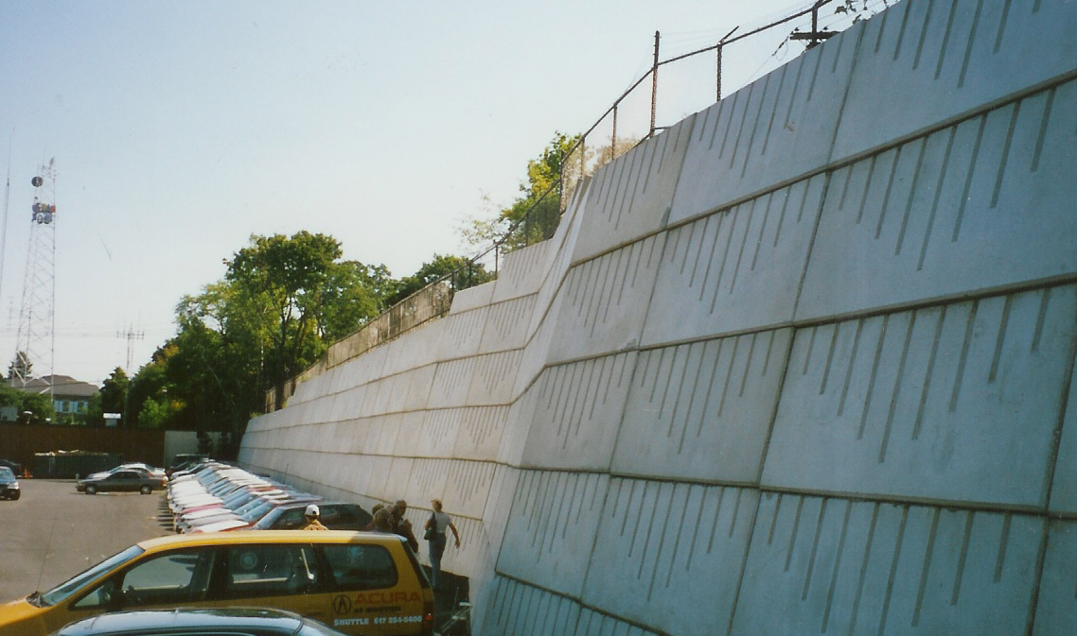
Car Dealer Parkinglot, Boston, USA

Slide 16
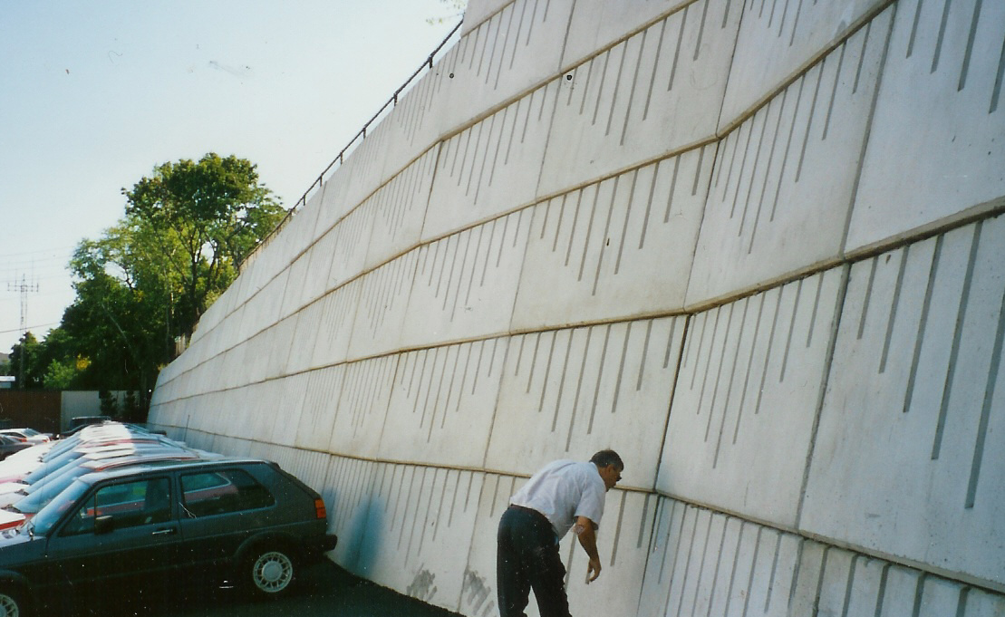
Checking details

Slide 17
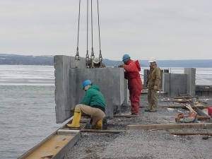
Everwall Maxi in Owasco, upstate New York, along an inlet canal to Lake Erie.

Slide 18
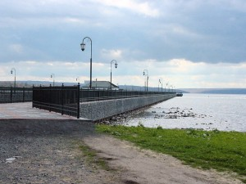

Slide 19
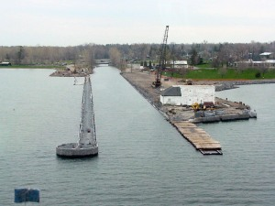

Slide 20
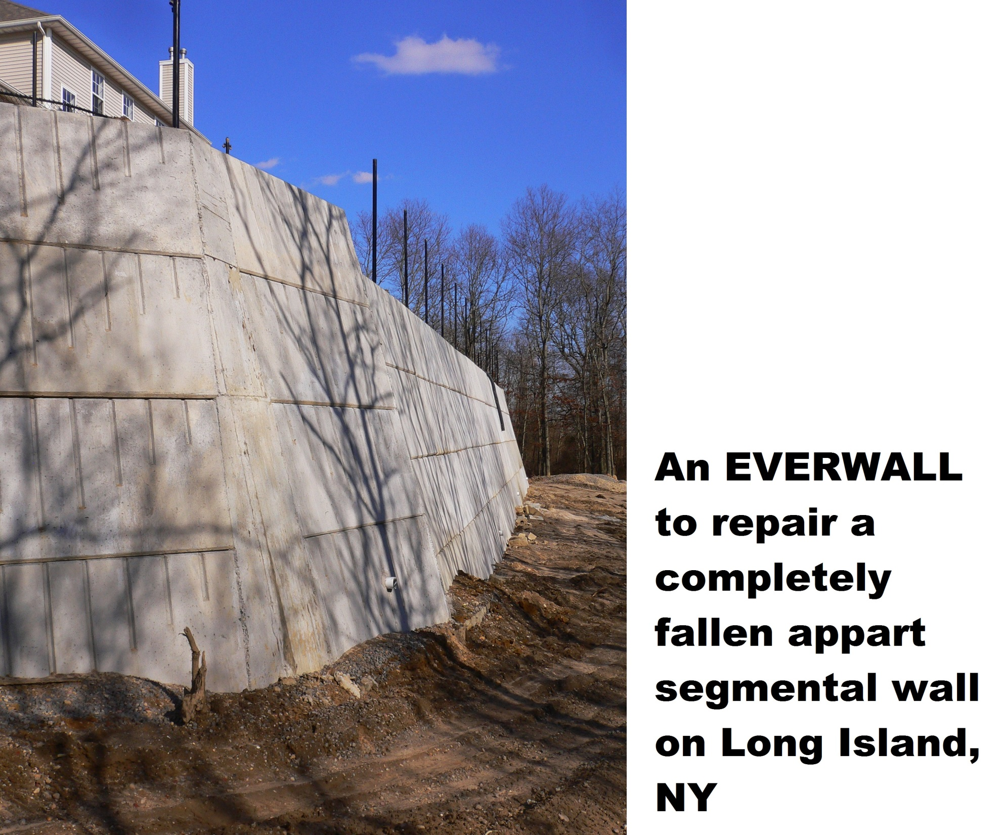

Slide 21
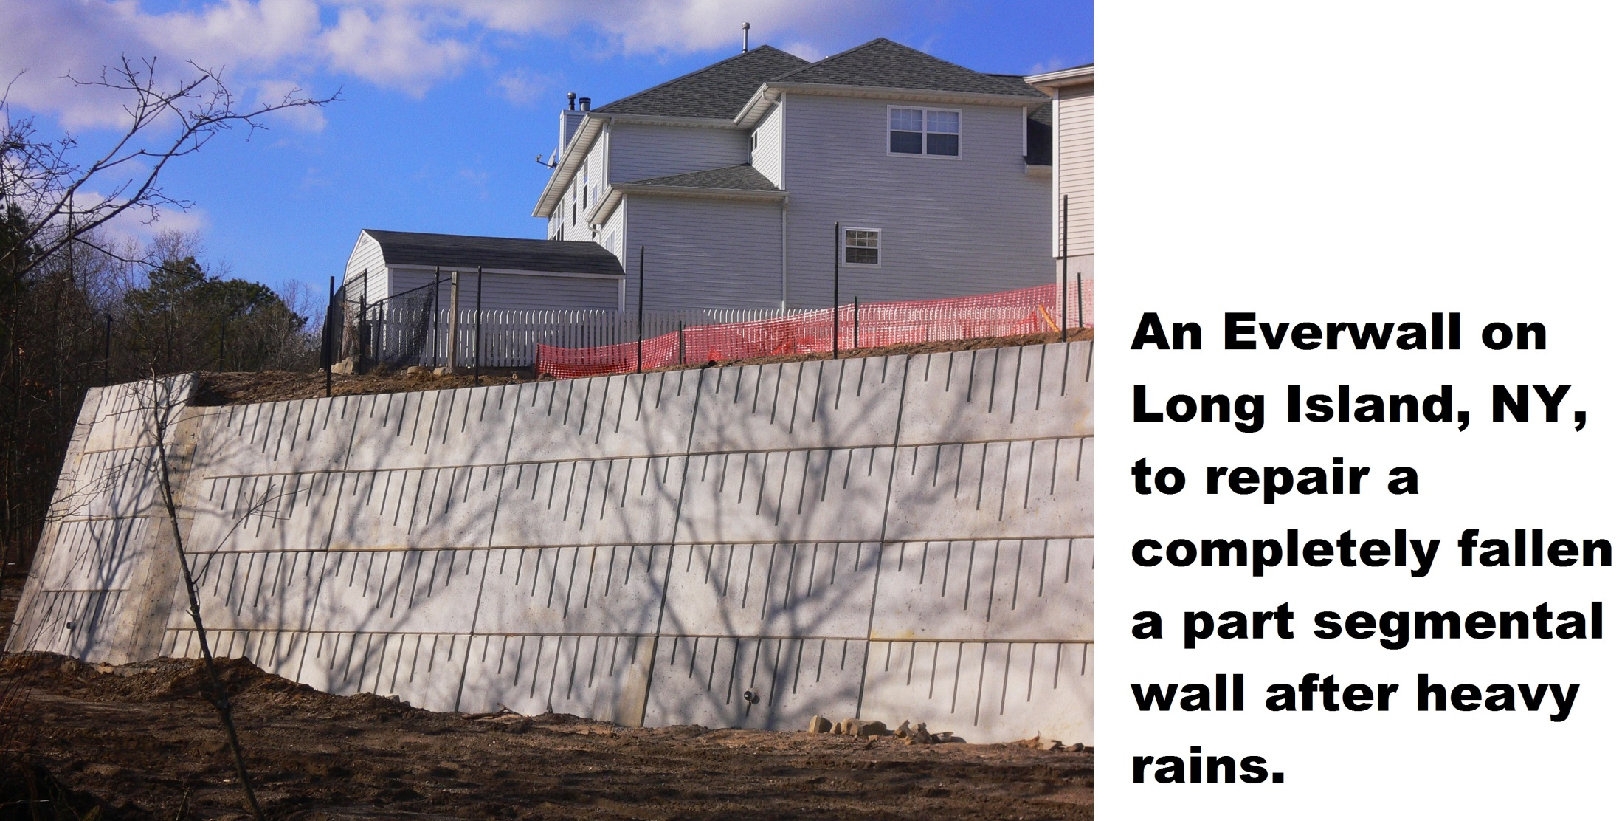

Slide 22
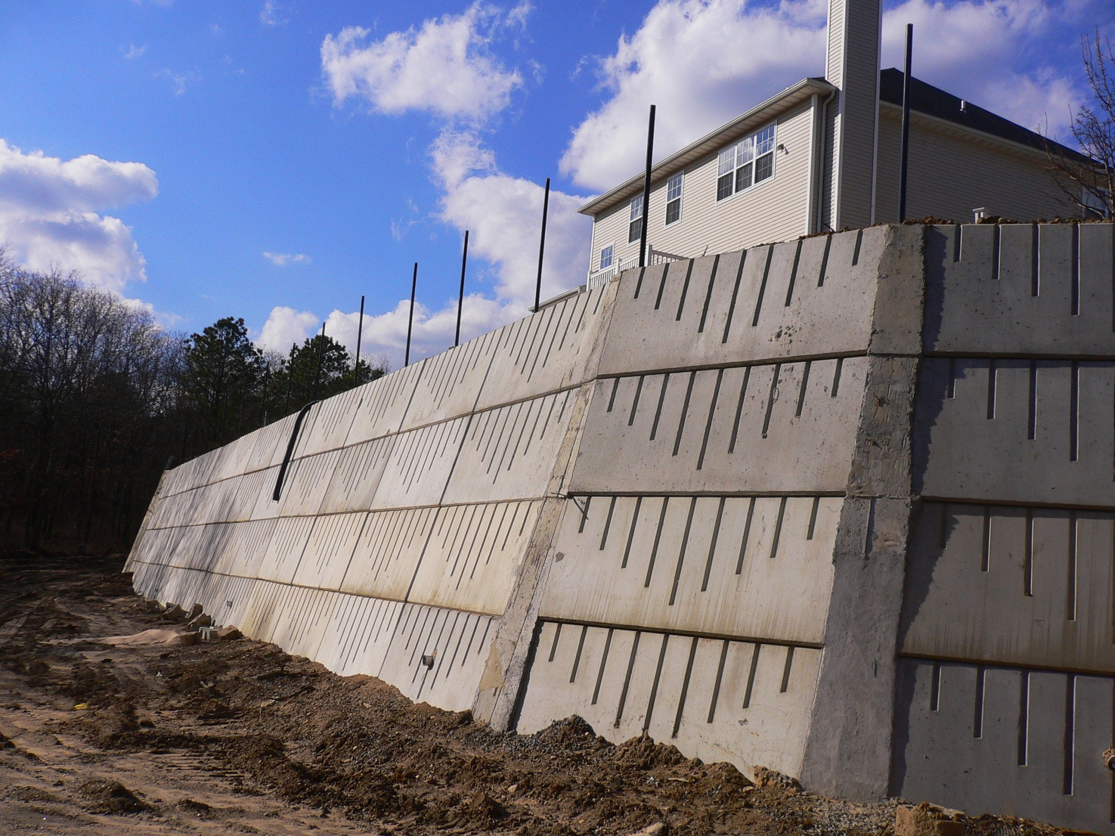
Everwall repairs a failed segemental wall
in Manorville, for the
Beachwood Development, on Long Island, NY.

Slide 23
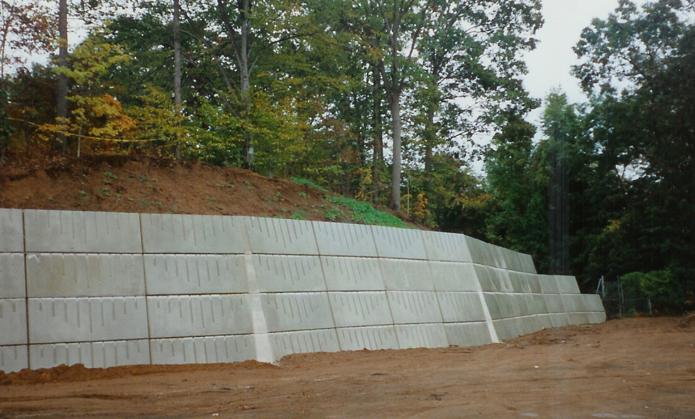
Bending Details for the
Pepsi Cola Factory in Puerto Rico, USA

Slide 24
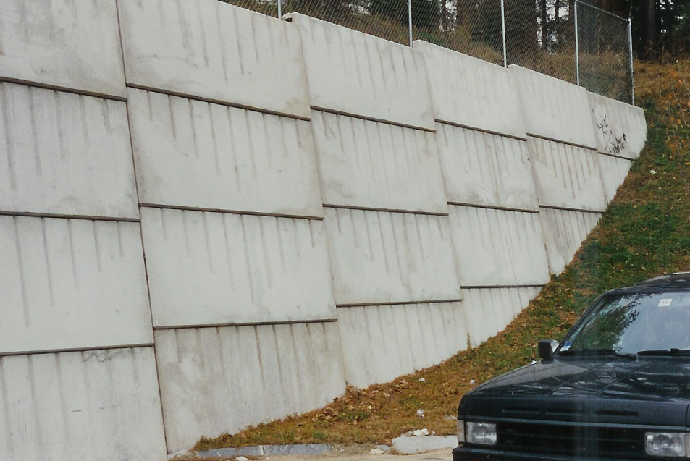
End of Everwall in Connecticut:
The foundation steps up at every joint !

Slide 25
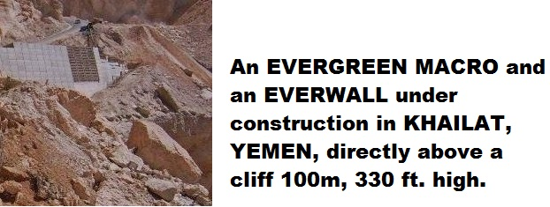

Slide 26
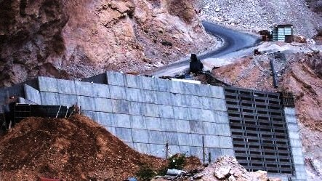
Everwall: 54 ft. high Khailat Hadramout Yemen
Build a local highway: above a cliff about 200 ft., 60m high;
below the foundation a cliff of 300 ft., 100m high , an amazing project. .

Slide 27
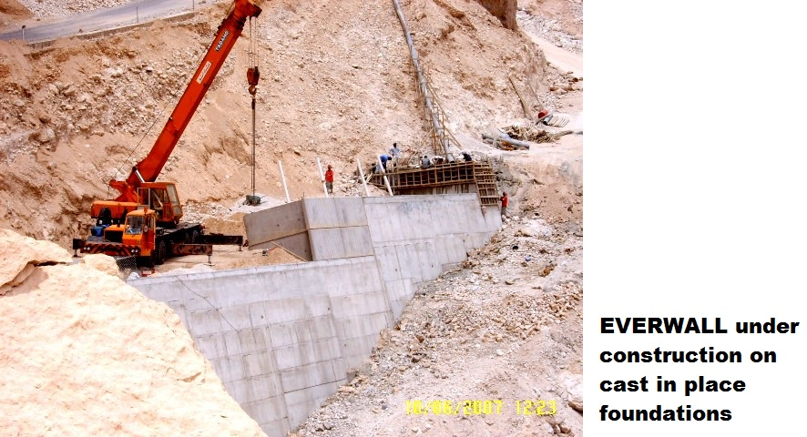

Slide 28
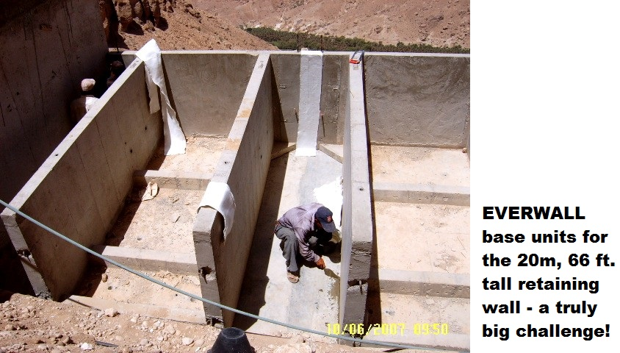

Slide 29
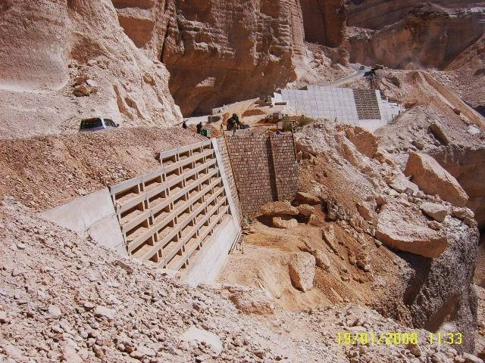
The retainig walls are about complete:
Evergreen MACRO and some Everwall

Slide 30
EVERWALLS built in
* Connecticut,
* New Hampshire,
* New York,
* Puerto Rico,
* Khailat, Hadramout, Yemen
by Evergeen Walls, Inc.

